Slide 1
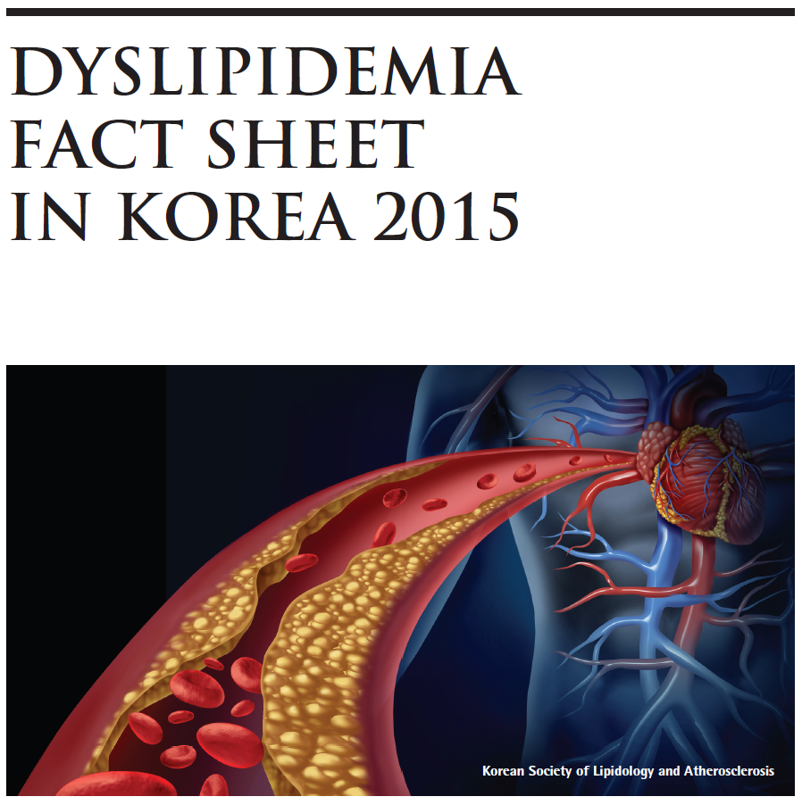

Slide 2
Data Sources
The estimates in this fact sheet were derived from data on the 2013 Korean National Health and Nutritional Examination Survey (KNHANES) conducted by the Korean Centers for Disease Control and Prevention (KCDC) and the Korean Ministry of Health and Welfare. The estimated percentage of people with dyslipidemia receiving lipid-lowering medication was determined from the National Health Insurance Service in Korea.
Definitions
The following terms were defined according to the Korean guideline for the management of dyslipidemia (3rd version) from Korean Society of Lipidology and Atherosclerosis (KSLA).
Hyper-LDL-cholesterolemia LDL-cholesterol (LDL-C) ≥160 mg/dL
or use of lipid-lowering medication for > 20 days/month
Hypertriglyceridemia Triglycerides (TG) ≥200 mg/dL.
Hypo-HDL-cholesterolemia HDL-cholesterol (HDL-C) <40 mg/dL.
Dyslipidemia One or more of the definitions stated above
or previous diagnosis of dyslipidemia
LDL-C: Low-density lipoprotein cholesterol
HDL-C: HDL: High-density lipoprotein cholesterol
TG: Triglycerides

Slide 3
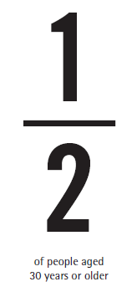
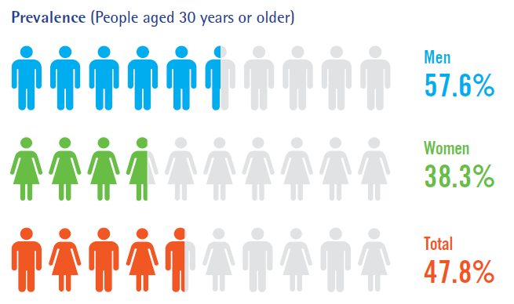
Prevalence of Dyslipidemia
• Approximately half of adults aged 30 years or older had dyslipidemia.
• About 6 out of every 10 men and 4 out of every 10 women were dyslipidemic.

Slide 4
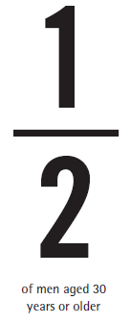
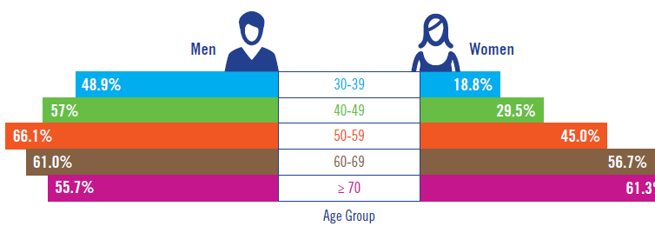
Prevalence of Dyslipidemia by Age Group
• Throughout all age groups of 30 years or older, about half of men had dyslipidemia.
• On the other hand, the prevalence of dyslipidemia in women tended to substantially increase after the age of 50.

Slide 5
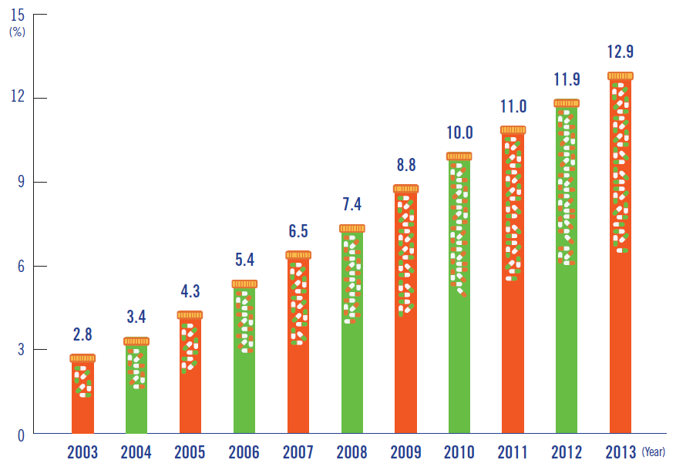
Treatment with Lipid-lowering Medication
• According to the data from National Health Insurance Service in korea, percentage of people with dyslipidemia receiving lipid-lowering medication was increasing for the past 10 years. In 2013, the percentage of patients receiving lipid-lowering medication was 5 times greater compared to 2003.

Slide 6
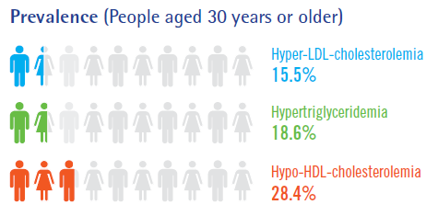
Prevalences of Dyslipidemia Subtypes
• About 1 out of every 6 adults aged 30 years or older had hyper-LDL-cholesterolemia,
and its prevalence was greater in women than in men.
• Prevalences of hypertriglyceridemia and hypo-HDL-cholesterolemia in men were
about twice as great as those in women.
• Among men aged 30 years or older, about 1 out of every 4 men had hypertriglyceridemia,
and 1 out of every 3 men had hypo-HDL-cholesterolemia.

Slide 7
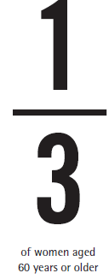
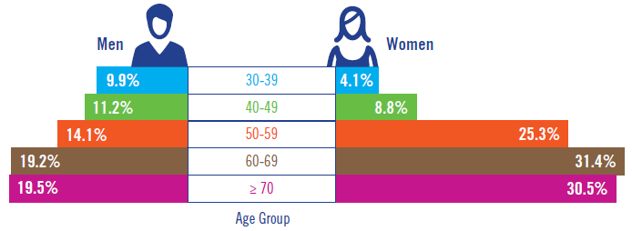
Hyper-LDL-cholesterolemia
• The prevalence of hyper-LDL-cholesterolemia increased with age, where 1 out of
every 5 men and 1 out of every 3 women aged 60 years or older had hyper-LDL-cholesterolemia.
• Percentages of women with hyper-LDL-cholesterolemia in their 50s were 6 times and
3 times greater than those of women in their 30s and 40s, respectively.

Slide 8
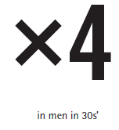
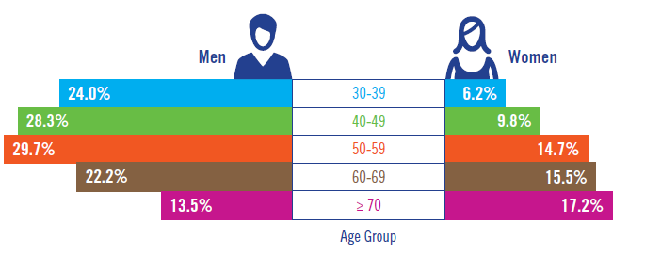
Hypertriglyceridemia
• Hypertriglyceridemia was more prevalent in men than in women. The prevalences of hypertriglyceridemia in their 30s, 40s and 50s were 4 times, 2.5 times and
2 times greater than those of women within the same age groups.

Slide 9
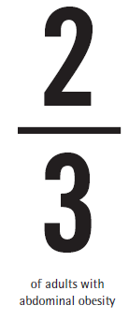
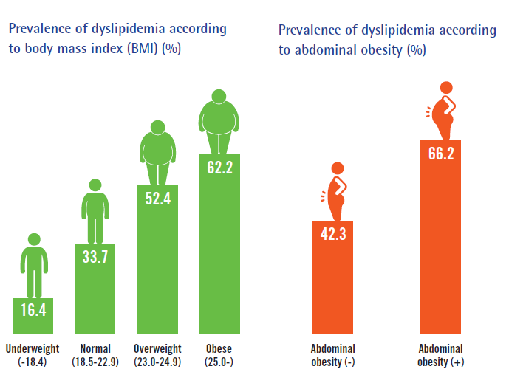
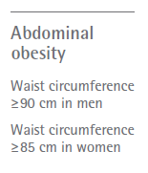
Obesity and Dyslipidemia
• About half of overweight or obese adults had dyslipidemia.
• Even within the normal range of body weight, 1 out of every 3 adults had dyslipidemia.
• In cases with abdominal obesity, 2 out of every 3 adults showed dyslipidemic profiles.

Slide 10
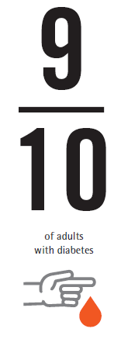
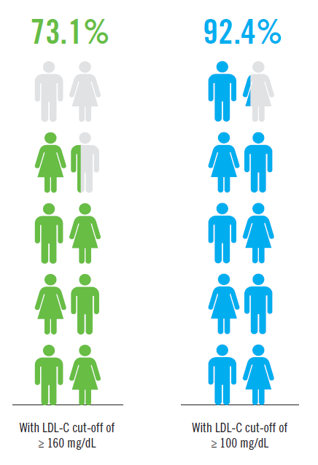
Diabetes and Dyslipidemia
• About 3 out of every 4 adults with diabetes had dyslipidemia.
• When the LDL-C cut-off value was strictly set to 100 mg/dL, more than 90% of people with diabetes had dyslipidemia.

Slide 11
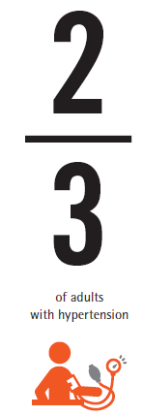
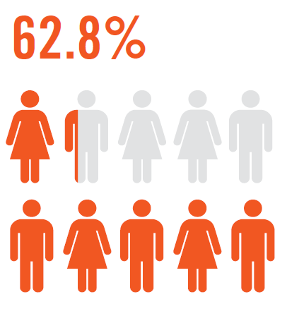
Hypertension and Dyslipidemia
• Approximately 2 out of every 3 adults with hypertension were dyslipidemic.

Slide 12
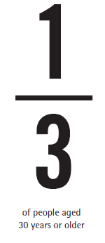
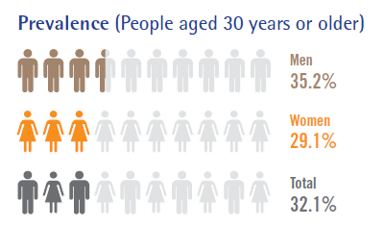
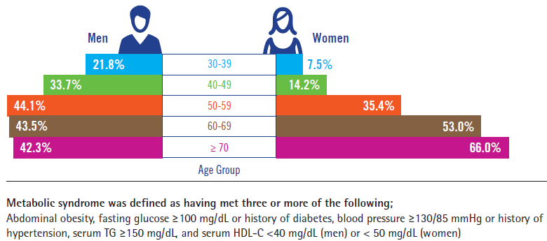
Prevalence of Metabolic Syndrome
• About 1 out of every 3 adults aged 30 years or order had metabolic syndrome.
• Percentage of men in their 50s or younger with metabolic syndrome was
2-3 times greater than that of age-matched women. In women with the ages of 50-59, a twofold increase in the prevalence of metabolic syndrome was observed.

Slide 13
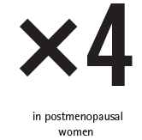
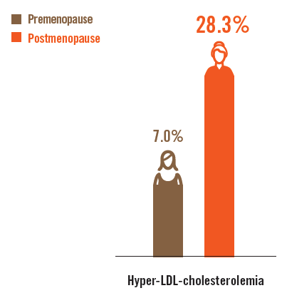
Hyper-LDL-cholesterolemia and Metabolic Syndrome in Postmenopausal Women
• Prevalences of dyslipidemia and metabolic syndrome in postmenopausal women were 4 times greater than those of premenopausal women.

Slide 14
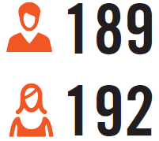
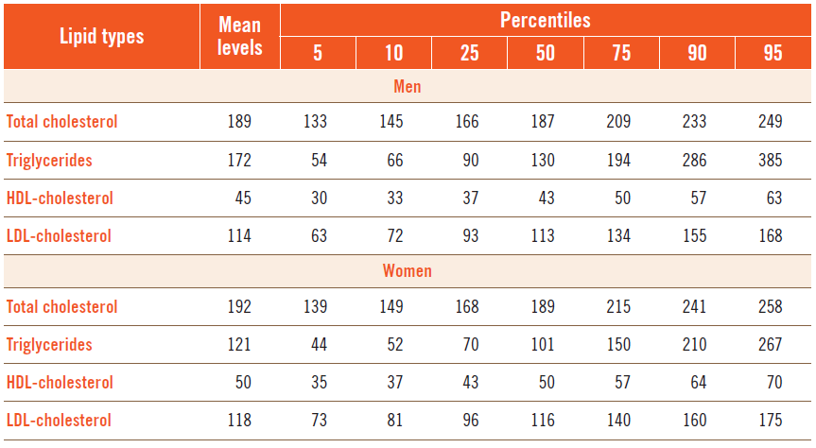
Average Lipid Profiles in Korea
• The mean (average) serum total cholesterol levels in adults aged 30 years or older were 189 mg/dL in men and 192 mg/dL in women.

Slide 15
SUMMARY (1)
DYSLIPIDEMIA
FACT SHEET
IN KOREA 2015
• More than 16 million (47.8%) Korean adults aged 30 years or older had dyslipidemia.
About 6 out of every 10 men (57.6%) and 4 out of every 10 women (38.3%) were dyslipidemic.
• Prevalence of dyslipidemia increased in an age-dependent manner, and it was more evident
in women with ages of 50 and over.
• Percentage of people receiving treatment with lipid-lowering medication increased by 5 times
in 2013 compared to 2003.
• About 1 in every 6 adults aged 30 years or older had hyper-LDL-cholesterolemia, and it was more common in women than in men. The prevalence increased in an age-dependent manner,
such that about 1 in every 5 men and every 3 women aged 60 years or older had hyper-LDL-cholesterolemia.
• In all age groups, prevalences of hypertriglyceridemia and hypo-HDL-cholesterolemia in men were approximately twice as great as those in women. Especially, in the age group of 30-39 years, the percentage of men with hypertriglyceridemia was 4 times greater than that of women.

Slide 16
SUMMARY (2)
DYSLIPIDEMIA
FACT SHEET
IN KOREA 2015
• Dyslipidemia was seen in 1 out of every 3 adults with normal body weight and in about half of overweight or obese adults. About 2 out of every 3 adults with abdominal obesity were dyslipidemic.
• About 3 out of every 4 adults with diabetes had dyslipidemia. When the LDL-C cut-off value was strictly set to 100 mg/dL, 9 out of every 10 adults with diabetes were diagnosed with dyslipidemia.
• Approximately 2 out of every 3 adults with hypertension had dyslipidemia.
• About 1 out of every 3 adults aged 30 years or older had metabolic syndrome.
• Prevalences of hyper-LDL-cholesterolemia and metabolic syndrome in postmenopausal women
were 4 times greater than those in premenopausal women.

